Slide 1
Prevention Steps….
Connect to help
Do Not Leave
the Person Alone
Notes:
Let them know that they are not alone – that you will help them get the help they need.
The resources the person has available can be a great source of strength in a crisis situation. Have them help you identify people, sources that have helped them in the past.
Work with them to make a plan of whom to contact in the event of recurring problems. Identify a number of options so if the first is not available there are others they can contact.
Build confidence that there is a safety net available and get them to promise not to act on self-destructive feelings when they occur, but to ask for help instead.
Follow up. Remember just because the crisis situation is over, the problems are probably not completely resolved. Continue to show you care.
Stay with the person until the immediate crisis has passed – if the person has a plan and has the means to carry out the plan than this is a crisis situation and you need to get help immediately – NEVER LEAVE THEM ALONE – get help immediately. Call 911 or take them to an emergency room

Slide 2
How to Help
In an acute crisis, call 9-1-1.
Do not leave the individual alone.
1-800-273-TALK (8255) option 1
Veterans Crisis Line
www.suicidepreventionlifeline.org

Slide 3
Resources for People at Risk for Suicide
Suicide Prevention Lifeline: 1-800-273-TALK (8255)
Mobile Crisis—SN/Rural: 702-486-7865 NN: 775-688-1670
Veterans Crisis Line: 1-800-273-TALK (8255), press 1
Emergency services, 9-1-1, local hospitals
MOST Team Non-emergency dispatch 775-334-2677
Problem Gamblers HelpLine 1-800-522-4700
VA Healthcare System 1-888-838-6256
The Trevor Lifeline: 1-866-488-7386
Reno Behavioral Healthcare Hospital 775-393-2249
Renown Children’s Emergency Room 775-982-6000
West Hills 800-242-0478
Safe Voice is (833) 216-SAFE http://safevoicenv.org/
Rural Clinics Care Team, Immediate Mental Health 1-877-283-2437

Slide 4
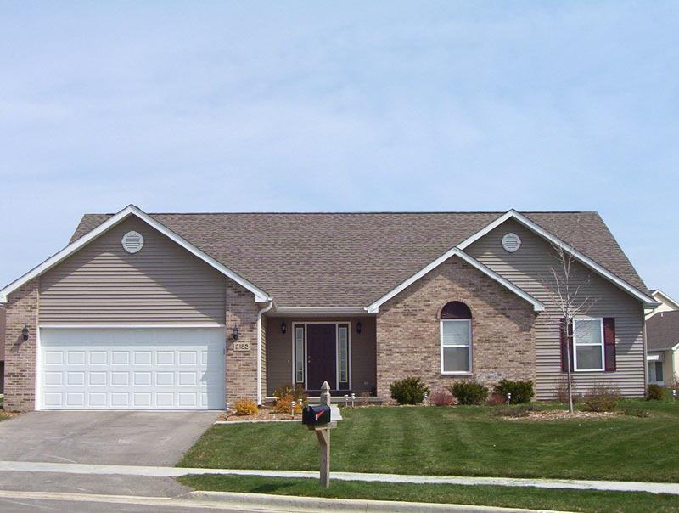
Crisis Now Model Core Elements
High-Tech Crisis Call Center
24/7 Mobile Crisis
Crisis Stabilization
Essential Principles and Practices
High-Tech
Home-Like
Their Place

Slide 5
7 Essential Elements of ZERO Suicide
LEAD
Train
ENGAGE
Identify
TREAT
IMPROVE
Transition
National Association of State Mental Health Program Directors National Action Alliance for Suicide Prevention
Zero Suicide

Slide 6
Our State Team Members
Team Lead
Nevada Air National Guard
Nevada Army National Guard

Slide 7
Collaboration
To all the Agencies who accepted the Mayor’s Challenge……
NDVS
U.S. Department of Veterans Affairs
Nevada Department of Health and Human Services, Division of Public & Behavioral Health
Office of Suicide Prevention
City of Las Vegas
Mayor of Sparks
Mayor of Reno
Northern Nevada Veterans Resource Center (VRC)
Center for the Application of Substance Abuse Technologies (CASAT), School of Community Health Sciences, UNR
Nevada Army National Guard Military & Family Support Services
Reno Vet Center
Truckee Meadows Community College Veterans Services
Truckee Meadows Veterans Community Council/ Nevada National Guard
Reno Police Department
Washoe County Human Services Agency, M.O.S.T.
Reno Air National Guard, 152nd Air wing
Reno-Sparks Indian Colonies
NAMI-National Alliance on Mental Health
MACCABEE Arms Ltd.
VVA
VFW
And more…

Slide 8
Contact:
Misty Vaughan Allen, MS
Suicide Prevention Coordinator
Nevada Office of Suicide Prevention
Email: mvallen@health.nv.gov
Direct: (775) 684-2236
Kim Donohue
Suicide & Homelessness Prevention Program Manager
Nevada Department of Veterans Services
Email: donohuek@veterans.nv.gov
Direct: (775)321-4708 or (775)825-9847

