Slide 1



Steve Sisolak
Governor
Richard Whitley
Director
State of Nevada
Department of Health and Human Services
Increasing Connectedness to End Suicide
Among Service Members, Veterans,
and their Families in Nevada
Office of Suicide Prevention
Misty Vaughan Allen, MA
Suicide Prevention Coordinator
December 10th, 2019
Division of Public and Behavioral Health
Administrator, Lisa Sherych
Helping People. It’s who we are and what we do.

Slide 2
With Gratitude to Caleb Cage
“The willingness with which our young people are likely to serve in any war, no matter how justified, shall be directly proportional as to how they perceive the Veterans of earlier wars were treated and appreciated by their nation.”
George Washington

Slide 3
“If we can create a society where respect and friendliness is the passport that we all have when we meet each other…then the military, who literally will go in harm’s way for us, will not seem alien anymore,…they’ll seem like your own brothers and sisters.”
Gen. James Mattis, USMC, Ret., Former U.S. Secretary of Defense, 2019 Reagan National Defense Forum

Slide 4

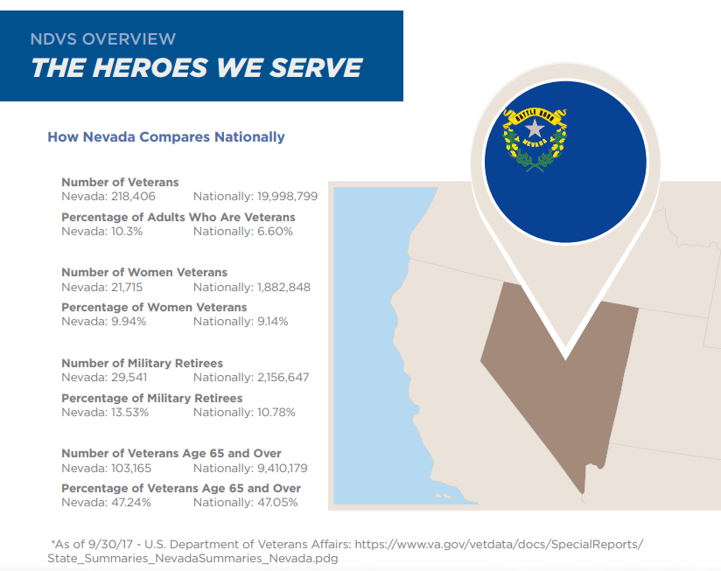

Slide 5
Suicide Rates in Nevada and the US --1997-2017

Slide 6
Key Facts About Veterans
Source: National Strategy for Preventing Veterans Suicide: 2018-2028

Slide 7
Veteran Suicide Deaths
Source: National Strategy for Preventing Veterans Suicide: 2018-2028

Slide 8
Recent Data Suggests:
Source: National Strategy for Preventing Veterans Suicide: 2018-2028

Slide 9
Suicide Statistics
United States, 2017
  Over 47,173 deaths
  Firearms used in over 51.6% of suicides (NV 52.5%)
  3.5 male deaths to every female death
  A suicide every 11.1 minutes
  129 Suicides a day
Nevada, 2017
  11th highest rate
  2nd leading cause of death 20-46, 1st for youth 12-19 years of age
  Nevada’s Elderly have highest rates 65+
  More suicides than homicides (221)and motor vehicle accidents (357)
Source: CDC WISQARS: 2017 Final Data
Notes:
42,773 suicide deaths in 2014. Approximately 1,069,325 (1M+) suicide attempts (using 25:1 ratio).
The number of suicide deaths reflects only a small portion of the overall impact of suicidal behavior.
In younger age groups suicide attempts are more often impulsive and communicative in nature. There are 3 female attempts for each male attempt.

Slide 10
Vital Signs Report, 2018

Slide 11
Veteran Suicide Rate per 100,000 Population 2013-2017

Slide 12
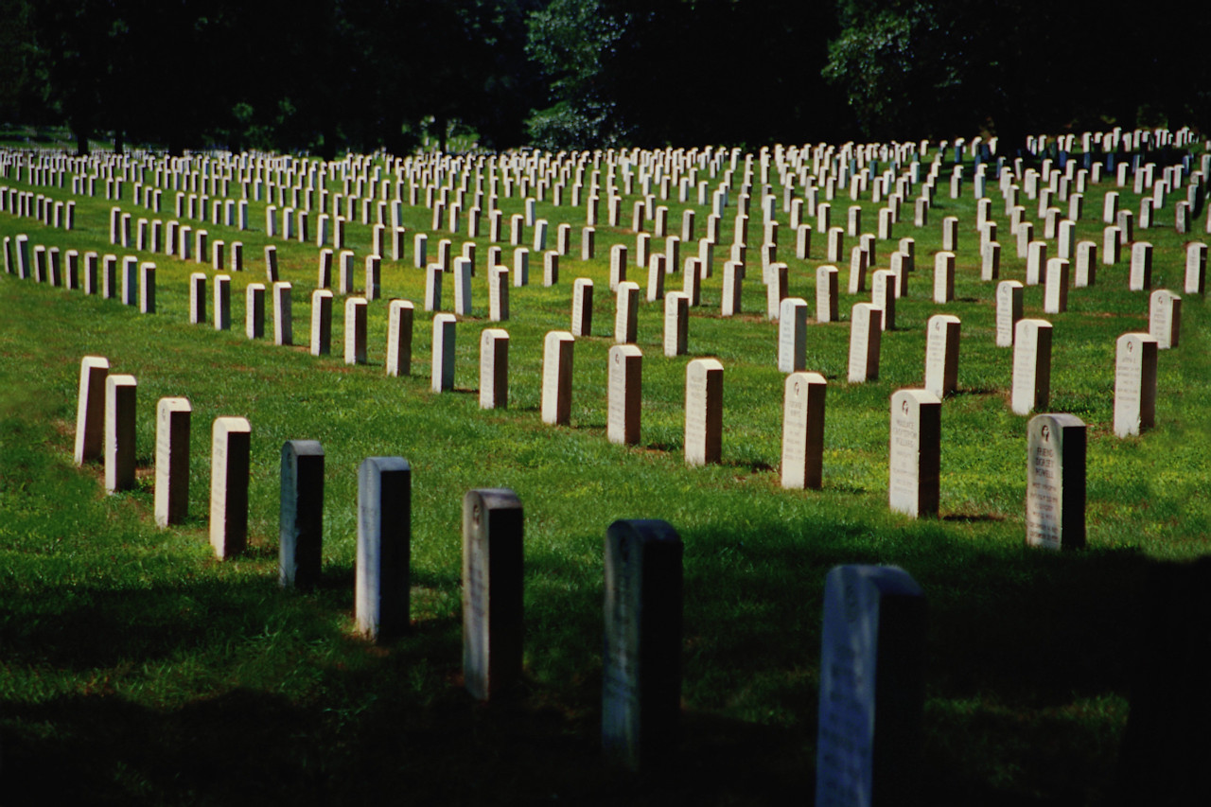
Suicide Mortality of Nevada
Veterans, 2008-2010
NEVADA ACTION PLAN FOR PREVENTION
Luana J. Ritch, PhD
Mental Health Services

Slide 13

Summary
Suicide prevention is a priority.
Facilitating lethal means safety among at-risk patients is an essential, evidence-based component of effective prevention programs.
Use the data to inform your efforts.
Don’t be afraid to innovate and think outside the box, both in one-on-one conversations and in programming/policy interventions.
The conversation requires practice—resources and training materials are available to help.

Slide 14
CDC 2018 report “Vital Signs”
54%
who died by suicide had no prior reported mental health diagnoses!
Does this mean the rest do not have mental health issues?

Slide 15
Risk factors
A highly stressful life event such as losing someone close, financial loss, or trouble with the law
Prolonged stress due to adversities such as unemployment, serious relationship conflict, harassment or bullying
Exposure to another person’s suicide, or to graphic or sensationalized accounts of suicide (contagion)
Access to lethal methods of suicide during a time of increased risk
Notes:
1 in 5 problem gamblers attempt suicide. This is double the rate of any other addictive disorder.

Slide 16
Protective factors
Receiving effective mental health care
The skills and abilities to solve problems
Connectedness – positive connections with family, peers, community and social institutions that foster resilience
Reduced access to lethal means
American Foundation for Suicide Prevention, 2013

Slide 17
Mayors’ Challenge Teams
Long Term Action Items
01
Develop a “Street Team” to promote firearms safety
within the firearms community.
REACH
LETHAL MEANS SAFETY
02
Advocate for policy change at highest level;
“Top Down” policy change with no consequences
for seeking help.
ADVOCATE
POLICY CHANGE
03
Advocate to medical boards to monitor physicians training on suicide prevention; i.e. safeTalk and ASIST Training provided by NCSP, OSP, VA professionals and other community partners, as well as postvention training.
TRAIN
PROPER TRAINING
04
AWARENESS
MILITARY CULTURE
Increase Military Cultural Awareness Training
Notes:
Strategy 1: Identify and Support People at Risk
Strategy 2: Promote Connectedness
Strategy 3: Strengthening Economic Supports
Operation Deep Dive-

Slide 18
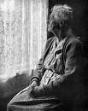

Prevention Steps….
SHOW
YOU CARE!
Listen Carefully
Be Genuine

Slide 19
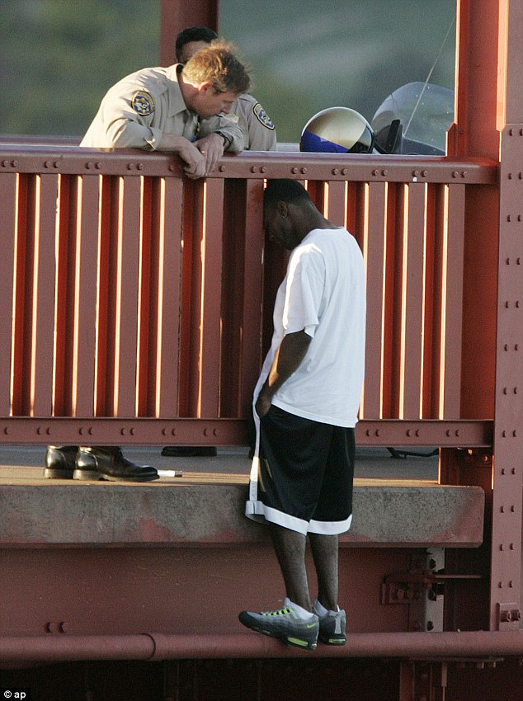
RESPONDING TO SUICIDE RISK SHOW YOU CARE…..
Listen Carefully
Kevin Berthia, was perched on the iconic bridge ready to take a fatal leap on March 11, 2005, when California Highway Patrol officer Kevin Briggs, left, talked him off the ledge and back to safety.
Over 60 life-changing minutes, Briggs managed to convince Berthia, as he has done with hundreds of suicidal men and women, to climb back over the rail and give life another shot. Since that significant day Berthia hasn't looked back and is now happily married with two children.
Story by Helen Pow, 12 May 2013
Past, Alone, Death
Uncertainty, Present, Engaged
Life, Future, Supported

Slide 20
Prevention Steps….
ASK
ABOUT SUICIDE!
Be direct, but
Non-Confrontational

