Slide 1
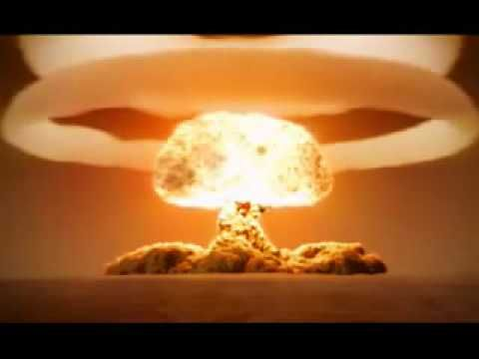
The Day We Narrowly Avoided a Nuclear Armageddon
with
Dr./Colonel Tyrus W. Cobb

Slide 2
Exercise “Abel Archer”
1983 Exercise “Abel Archer” conducted amid increasing tensions between the Soviet Union and the United States.
Exercise called for gradually raising the “DefCon” level.
Abel Archer culminated in the launch of a preemptive nuclear strike.

Slide 3
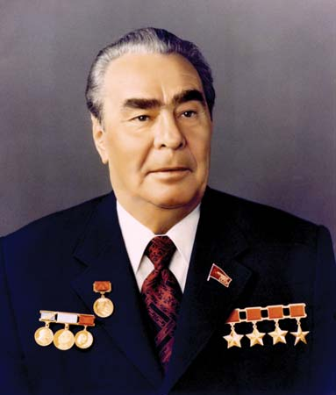
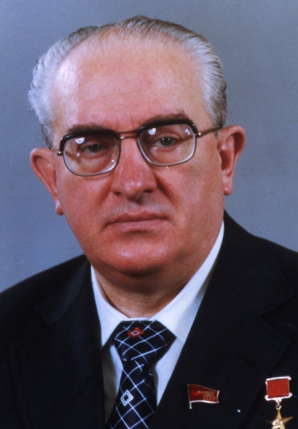
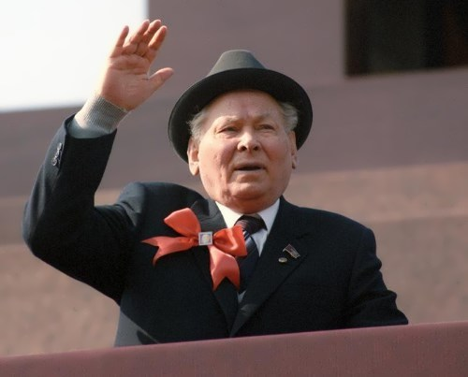
Soviet National Security Decision Making in the Early 1980’s
Soviet national security decision making narrow and closed to dissenting opinions.
Leadership in the Kremlin increasingly a “Gerontocracy”. From Brezhnev to Andropov to Cherenko.

Slide 4
Soviet Perceptions of Reagan Objectives
Soviet analyses increasingly simplistic and stressed worst case conclusions.
Soviet leadership genuinely concerned U.S. contemplating a “disarming first nuclear strike”.

Slide 5
American Actions and Statements Lend Credence to Soviet Fears
U.S. begins conducting military exercises that Moscow interprets as first steps in actual strike on USSR.
American Navy challenges near USSR under “freedom of navigation”.
U.S. strategic bombers enter Soviet airspace during exercises.
Korean civilian airliner KAL007 crosses Soviet airspace en route to Seoul.
President Reagan jokes about launching nuclear strike on the USSR…. Secretary Haig threatens to send “nuclear warning shot across the bow”.

Slide 6
Soviet Leadership Orders Nuclear “Retaliatory” Strike on U.S.
At height of “Abel Archer” Kremlin convinced that U.S. will launch preemptive nuclear strike.
Soviet high command orders Colonel Petrov to launch ICBM’s from his missile site. He refuses.
Petrov relieved, his successor told to launch the strike.
Soviets discover radar indications of U.S. nuclear missile launch were instead a flock of birds!!
When it became clear that Soviet leadership was interpreting this as a real nuclear strike on the USSR, a U.S. General ordered the immediate termination of the exercise.

Slide 7
Conclusions
In the early 1980’s Soviet decision making was closed and prone to worst case analyses.
U.S. leadership not sensitive to actions or statements that would be considered threatening by Moscow.
“Abel Archer” exercise came dangerously close to nuclear exchange. But just how close remains uncertain.

