Slide 1
Ballistic Missile Defense Ready and Relevant
BG Greg Bowen
Deputy Commanding General
for Operations
USASMDC/ARSTRAT

Slide 2
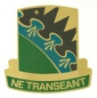
1958 U.S. Army Launches Explorer I
1962 First Intercept of ICBMs
1963 First Satellite Intercept
1964 Kwajalein to Army (from Navy)
1967 Sentinel System
1969 Safeguard System
1978 Directed Energy Research Initiated
1984 First Hit-to-Kill Intercept of Missile in Space
1987 First Hit-to-Kill Intercept of
a Tactical Ballistic Missile
Designation of Army Space Command
1990 High Energy Laser Systems Test Facility Transferred to Command
Army Air/ Missile Defense Lead Integrator
Transferred Army
Forces Cyber Command to ARCYBER
ASCC to U.S. Strategic Command
U.S. Army Space and Missile Defense Command
1957 1969 1974 1985 1988 1992 1997 2002 2010 2014
Army Space and Strategic Defense Command
Army Space Command
1991 All Theater Missile Defense Transferred to Command
1997 First Lasing of Satellite by Ground-Based Laser
Hit-to-Kill with Patriot & Terminal High Altitude Air Defense
2001 Computer Network Operations Mission Added
2002 High Altitude Proponent
2003 1st Space Brigade and 100th Missile Defense Brigade (GMD) Activations
2008 Nanosatellite Development
2010 Launched SMDC-ONE
2014 Air and Missile Defense Lead Integrator
Army Strategic
Defense Command
Ballistic Missile
Defense Organization
Safeguard System Command
Redstone Antimissile Missile System Office/ NIKE-ZEUS/NIKE-X/Sentinel Programs

Slide 4
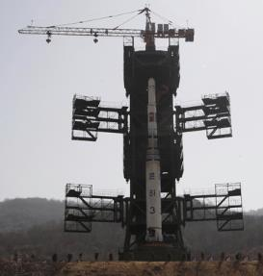
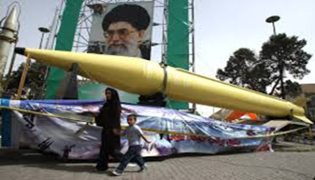
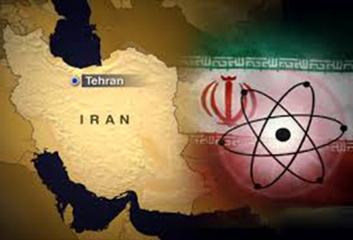
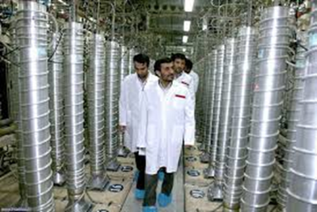
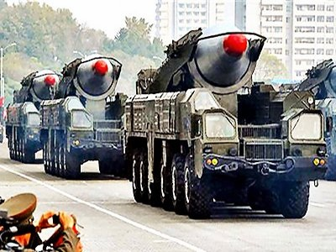
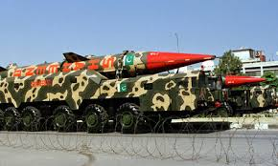
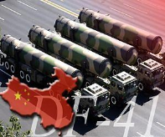
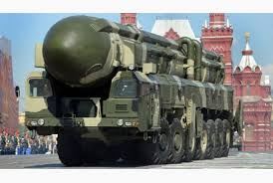
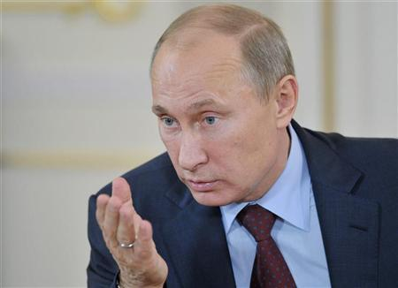
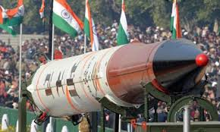
Strategic Environment
North Korea
Iran
The world is not getting safer…
Gen Dempsey
Chairman of the Joint Chiefs
Pakistan
China
Russia
India
Syria
4

Slide 6
Conclusion
Questions
BG Greg Bowen
Deputy Commanding General
for Operations
USASMDC/ARSTRAT

