Slide 1
WORLD OIL PRODUCTION 2009-2014
: 84 mbd or 30.6 Billion Barrels per year
2014: 90 mbd or 32.8 Billion Barrels per year
Notes:
Sources for Statistics: DOE, Energy Information Agency’s “Annual Energy Outlook 2014” and the “BP Statistical Review of World Energy 2014, June 2014”

Slide 2
US OIL PRODUCTION FACTS 2009-2014
US OIL PRODUCTION INCREASED BY 62% OF WHICH SHALE IS NOW 26%
TOTAL IMPORTS DECREASED FROM 65% TO 45% OF US CONSUMPTION, BUT OPEC IMPORTS DECREASED BY 23%.

Slide 3
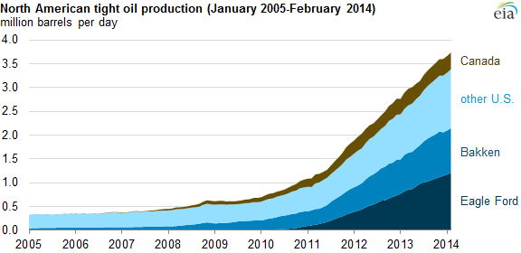
US SHALE OIL PRODUCTION

Slide 4
US OIL PRODUCTION FACTS 2009-2014
PERSIAN GULF IMPORTS NOW ONLY 7% OF TOTAL US CONSUMPTION
BRENT PRICE PER BARREL WENT FROM $61 IN 2009 UP TO $144 IN 2008 AND THEN BACK DOWN TO JUST UNDER $50 TODAY

Slide 5
IMPACTS OF INCREASED DOMESTIC PRODUCTION
1. NEW “PEAK OIL” FOR US IN NEXT 4 YEARS but NEW PEAK COULD BE 4 MBD HIGHER IN BEST CASE SCENARIO AT 13.3 MBD VS 9.6MBD IN 1970
2. NO NEED TO IMPORT FROM OUTSIDE OF THE WESTERN HEMISPHERE BY THE END OF 2016

Slide 6
IMPACTS OF INCREASED DOMESTIC PRODUCTION
NET NATURAL GAS EXPORTER BY 2020
US INDUSTRIAL PRODUCTON INCREASES FOR THE NEXT 15 YEARS, MOSTLY IN BULK CHEMICALS AND ENERGY INTENSIVE INDUSTRIES.
U.S. VMT (Vehicle Miles Traveled) CONTINUE UP BUT ACTUAL GAS CONSUMPTION CONTINUES TO GO DOWN

Slide 7
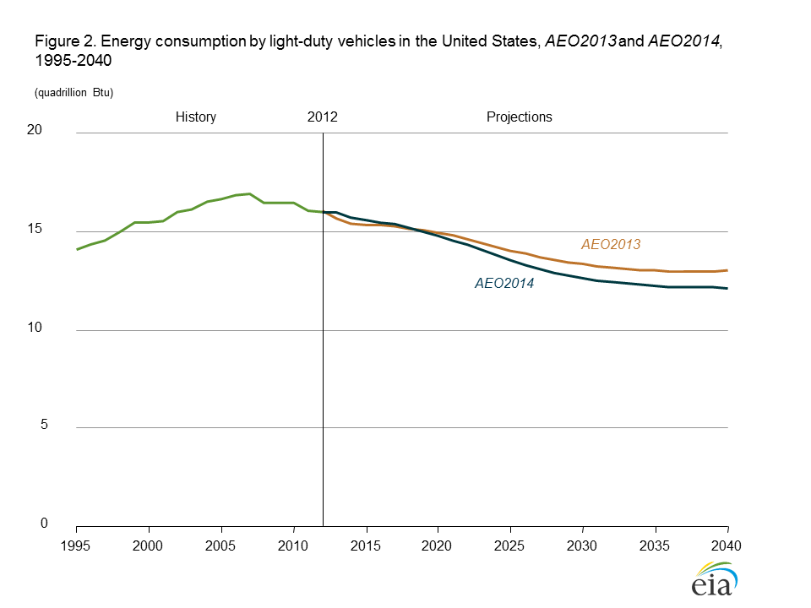
U.S. VEHICLE ENERGY USE ESTIMATES

Slide 9
SURGE IN GLOBAL OIL/GAS PRODUCTION AND CONSEQUENT DROP IN PRICE HURTS RUSSIA MORE THAN ANY OTHER COUNTRY
Russia a “nuclear armed banana republic”
Economy heavily dependent on oil/gas revenues
Russia had long been #1 oil/gas producer and exporter (#2 for oil)
In last decade Russia flying high on oil at $140
Depends on oil/gas exports for 65% of budget revenues!

Slide 10
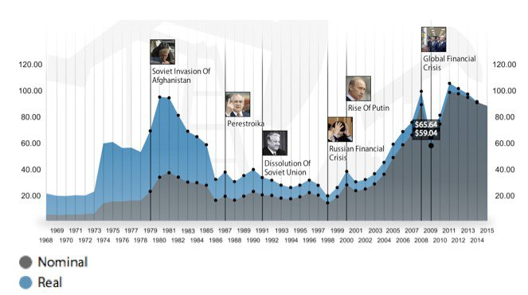
Notes:
A balanced budget for Russia depends on an average price of crude oil between $110 and $115 per barrel. But with prices recently falling below $90 and signs that the price may stay low for the foreseeable future, the country may experience shortfalls. Here is where the price of oil was over the past 35 years as major events were taking place in Russia. (Source: U.S. Energy Information Administration. Pegged to U.S. import price)

Slide 11
RUSSIA’S ECONOMY MOVES INTO RECESSION
Russian economy in “free fall”; worst crisis since 1998 (default)
Russia GDP will decline this year by 4% w/oil at $60 (at least)
50% drop in global oil prices cause Moscow to lose $100B
Sanctions over Crimea annexation and Ukraine incursion also hurt
Value of ruble declines x%; now at 63 for the dollar (down from 33)
Despite efforts of Central Bank to prop it up
Russia will import 40% less goods (mainly food!!)
Inflation soaring; interest rates rise to 17%; capital flight out of Russia

Slide 12
DOMESTIC AND EXTERNAL RAMIFICATIONS
Doubtful Moscow can accomplish ambitious $770B defense modernization programs
Have to cut back on imports; very dependent on food from abroad
Economy needs structural reform; now a “kleptocracy”; crony capitalism at its worst
Economic problems compounded by severe demographic trends
Putin’s popularity soars; now at 80% approval
Much due to elimination of dissident voices; jingoistic press; campaign to blame nefarious West for all its problems
“Nationalist Hysteria” sets in; Putin becomes mythical figure

Slide 13
HOW WILL PUTIN AND RUSSIA CONFRONT THE CHALLENGE?
By instituting badly needed economic reforms? Doubtful
By increasing authoritarianism? Nationalist phobia? Myth of being surrounded? Likely
By striking out against the West? Is the “Wounded Bear” more dangerous in a weakened state? Unlikely, but…..

