Slide 1
THE NEW CALIPHATE (ISIS-IS)
Radical Islam at War
with the World
John Jandali
Lawrence Martines
Richard Hobbs
Tyrus Cobb
National Security Forum
7 August 2014

Slide 2
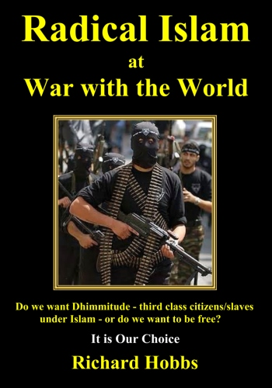

Slide 3
The Origins of the Islamic State
Richard Hobbs
National Security Forum
7 August 2014

Slide 4
Abu Musab al-Zarqawi
● Video – cut off Nicholas Berg’s head
● 2004 letter to AQ - provoke Shiites
● OBL – named him “emir of al Qaeda in the Country of the Two Rivers”
● Al Qaeda in Iraq (AQI)
● Boasted he would undo Sykes-Picot

Slide 5
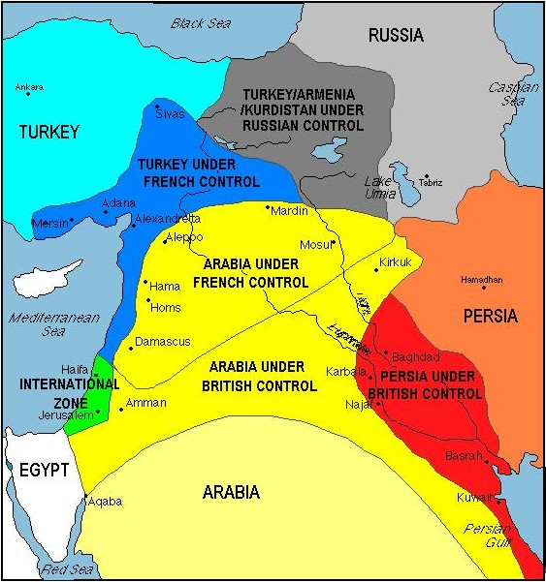
Sykes-Picot Agreement
Sykes-Picot Line
Notes:
Signed 8 May 1916

Slide 6
20-Year Plan
Fouad Hussein, 2005 book
“Al Zarqawi: The Second Generation of Al Qaeda”
9/11 -2003 “The Awakening”
2004-2006 “Eye Opening”
2007-2010 “Arising and Standing Up” (partition Syria, Lebanon, Jordan into sectarian statelets)
2011-2013 Bring down secular Arab governments, attack oil facilities
2014-2016 Announce Caliphate
2017-2020 Form Islamic Army and instigate worldwide fight to “definitive victory” by 2020

Slide 7
Zarqawi condemned democracy
● Democracy calls for obedience to man, not Allah;
● democracy permits freedom of religion, even to convert to another religion;
● the people rather than Allah rule and pass judgment under democracy;
● freedom of expression under democracy would permit condemning Allah [the cartoon jihad];
● separation of church and state permits secularism which is totally inconsistent with Islam;
● freedom of association would permit one to join an unacceptable party; and finally,
● the concept of majority rule is “totally wrong and void because truth according to Islam is that which is in accordance with the Koran and the Sunna, whether its supporters are few or many.”
Notes:
in a speech before the January 2006 elections in Iraq:

Slide 8
● Reprimand from Zawahiri for killing Shiites
● Killed by USAF 7 June 2006
● Islamic State in Iraq (ISI)
● Osama bin Laden - July 2006 called for Zarqawi’s successor, Abu Hamza al-Kuhajer,
“to transform Iraq into the center of an Islamic caliphate”

Slide 9
Abu Bakr al-Baghdadi
● 2005-9 Camp Bucca
● 2010 head of ISI
● 2011 ISI into Syria
● 2012 Al Nusra Front
● 2013 formed ISIS*
● $10 Million Bounty
*Islamic State of Iraq and al-Sham (Levant)

Slide 10
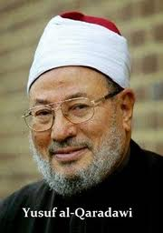
Sunni-Shia Hatred
Muslims are “required” by jihad to go to Syria. I call on Muslims everywhere to help their brothers be victorious.
Everyone who has the ability and has training to kill is required to go.
Alawites are more infidel than Christians and Jews and HezbAllah is the Party of the Devil.

Slide 11
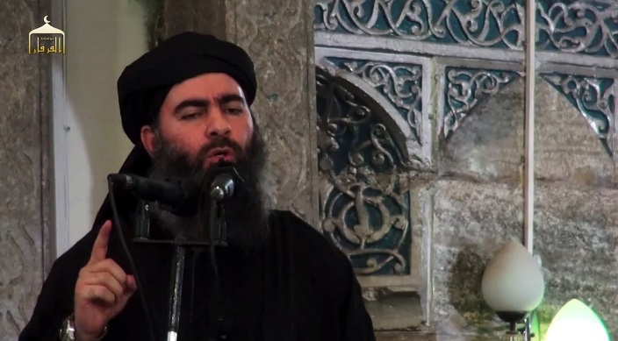
Abu Bakr al-Baghdadi
Born Ibrahim Ali al-Bakri, 1971
Also uses nom de guerre – Abu Duaa
“Father of the Summons”
Doctorate in Islamic Studies
“Khalifa Ibrahim” or
Caliph Abraham

Slide 12
ISIS
● Feb 2013 Disavowed by Zawahiri
● 7,000 fighters in Syria, 3,000 in Iraq
● Perhaps ½ - 5,000 – are foreign
● Declared Caliphate 29 June 2014
● “State of the Islamic Caliphate” on passports

Slide 13
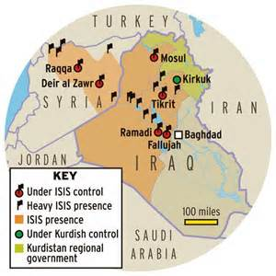
Cancels Sykes-Picot
16 Wilayats

Slide 14
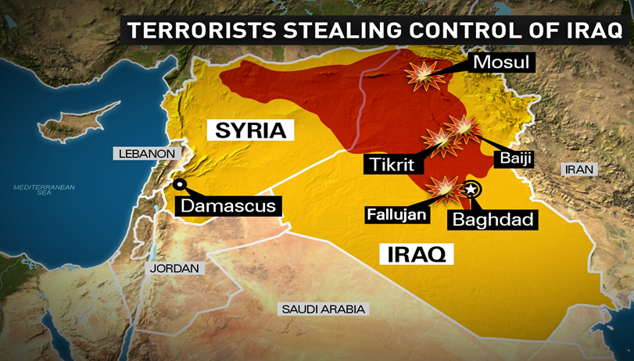
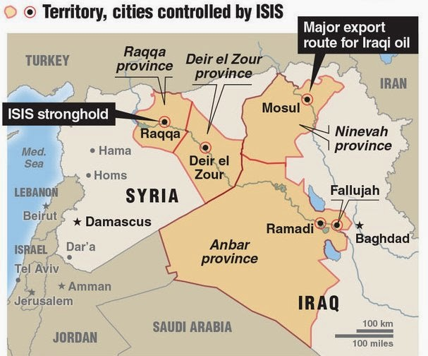
_____
_______
______

Slide 15
Islamic State (IS)
● Now more an irregular army or full- blown army than a terrorist group
● Has: weapons, personnel, fighters,
leadership, organization,
resources (captured equipment, $2B),
controls territory,
and momentum to maintain control for now
Notes:
“..now a full-blown army” Brett McGurk, Deputy Assistant Secretary of State for Iraq and Iran in Congressional testimony, 23 July 2014.

Slide 16
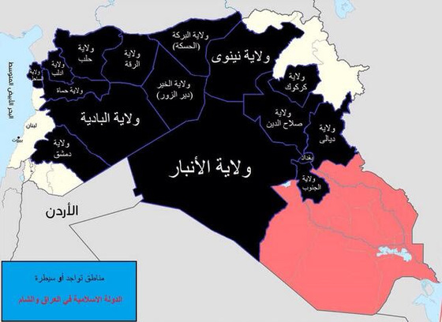
Blue box reads "Areas of presence or control; The Islamic State in Iraq and the Sham." The map details the 16 administrative districts [wilayats], which are divided largely along existing provincial boundaries in both Iraq (7) and Syria (9).

Slide 17
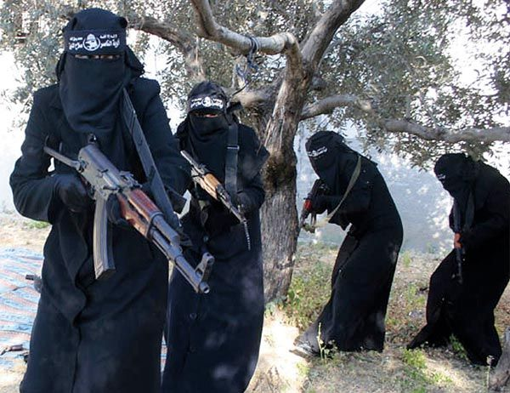
Al- Khansaa’ Brigade - Raqqa

Slide 18
IS orders shopkeepers to veil mannequins
Notes:
Mosul

Slide 19
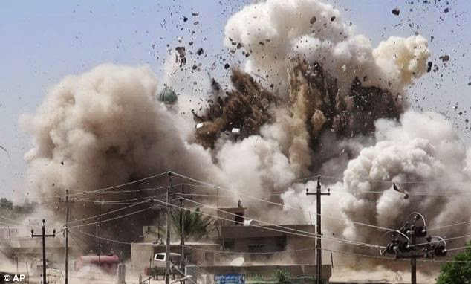
Mosque of the Prophet Younis (Jonah), Mosul, 24 Jul 2014

Slide 20
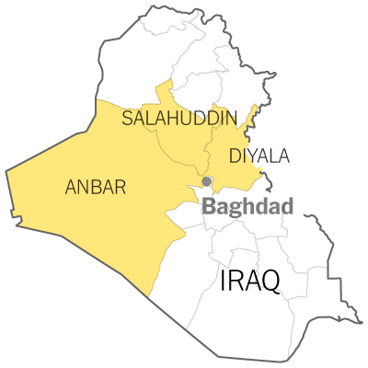
Militant Groups N & W of Baghdad
● Naqshbandia Order/J.R.T.N.
Baathist – fighting in D &A
● 1920 Revolution Brigades
Baathist - fighting in D & A
● Islamic Army of Iraq
Active in all 3
Diyala
● Mujahedeen Army Salafist – Truce
● Khata’ib al-Mustapha Salafist – Truce
● Army of Muhammad Salafist – Allied
● Khata’ib Tawrat al-Ashreen anti-Gov’t tribe -Truce
● Ansar al-Islam/Ansaral-Sunna Islamist Jihadist
fighting in Diyala

Slide 21
50 Soldiers Beheaded and their Heads Put on Poles

Slide 22
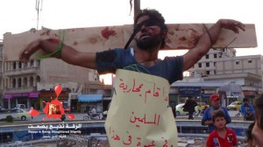

Slide 23
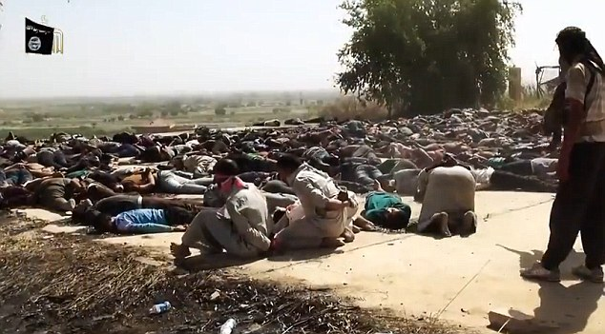
Caliphate video 28 July 2014
Shocking brutality: those last two about to be shot – other scenes with group executed in sand and others shot in head and pushed into river
Notes:
Shoots the last two next

Slide 24
The Kurds, Kurdistan, and the Peshmerga
Lawrence Martines
National Security Forum
7 August 2014

Slide 25
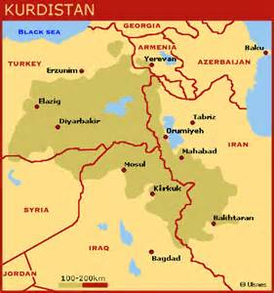
Kurdistan

Slide 26
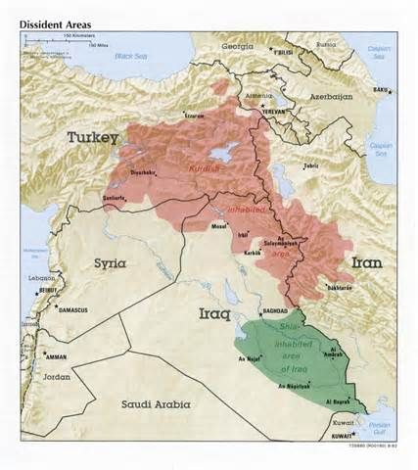
Kurdish Inhabited Area

Slide 27
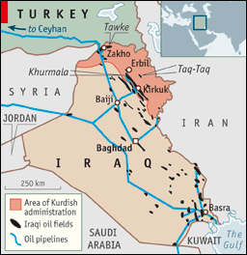
Oil Fields and Pipelines

Slide 28
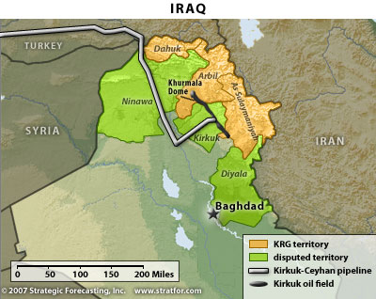
Kirkuk-Ceyhan Pipeline

Slide 29
Significance to the Region and the World
John Jandali
National Security Forum
7 August 2014

Slide 30
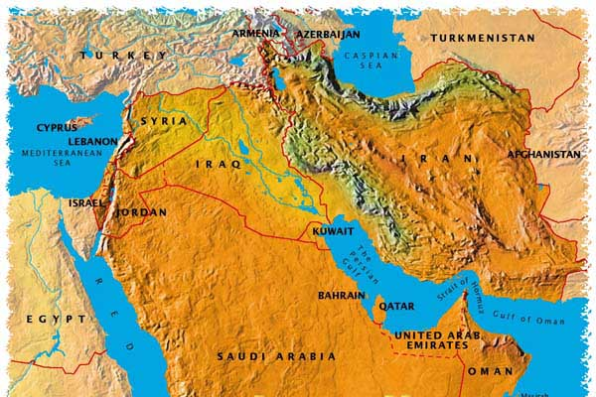

Slide 31
Middle East

Slide 32
The New Caliphate

Slide 33
The World as ISIS Sees It
Notes:
From Daniel Pipes, The Washington Times 5 August 2014

